Slide 1
Dependable and Secure AI
Introduction

Slide 2
Can AI-based Components be Part of Dependable Systems?

Slide 3
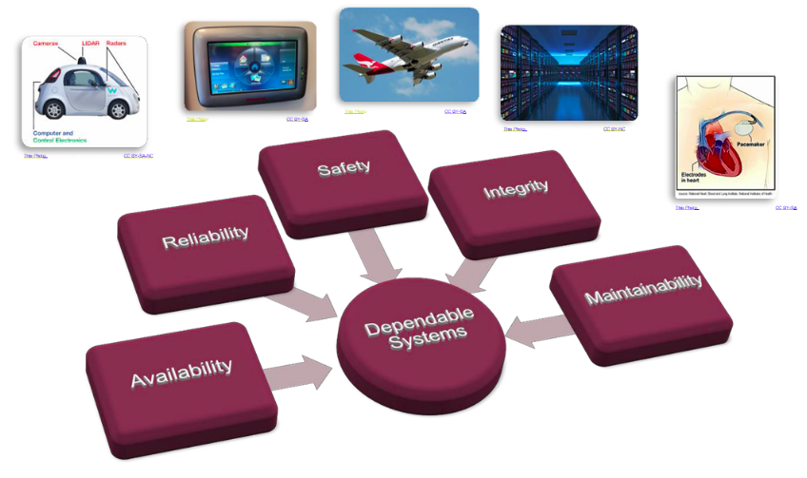
Dependable Systems
Dependable Systems can be found in many forms and application domains, but especially in transportation systems, medical systems and recently in the domain of IoT and Industry 4.0.*
*Industry 4.0 has been defined as “a name for the current trend of automation and data exchange in manufacturing technologies, including cyber-physical systems, the Internet of things, cloud computing and cognitive computing and creating the smart factory”

Slide 4
“Dependability”
Reliability how often is the system allowed to fail
Availability to which extend is the system usable, when it is needed
Maintainability how intense is the maintenance of the system
Safety how must the environment be secured against the system
Security how must the system be protected against the environment

Slide 5
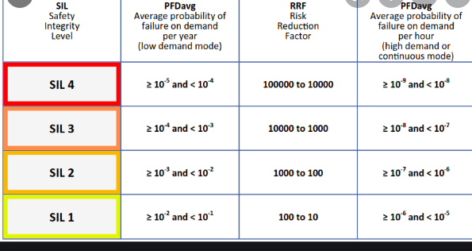
Safety Integrity Level : Standard
Safety Integrity Levels (SIL) define the criticality of the component,
Each SIL requires different development techniques as well as testing or verification methods and techniques.
The SILs are defined by the probability of failure, a risk reduction factor (can the risk of failure be reduced by a certain amount, using multiple instances, redundancy, etc), probability of failure per hour and the meantime between failure.
IEC 61508
Automatic protection systems called safety-related systems

Slide 6
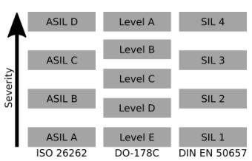
Standards: Safety integrity level (SIL)
SIL1 being the lowest and SIL4 the highest severity level:
For example in SIL4 :
high coverage of branches in the source code of a component
ensures adequate testing of the most critical components in the system.
standard procedure in avionic or automotive applications.
Civil avionic systems : regulated by DO178c
train applications DIN EN 50657
Medical devices are certified under IEC 82304, 2018 [4]
Automotive under ISO 26262 [5].
Each of these standards defines strict requirements with the goal to ensure the the functional safety of each component

Slide 7
Ensuring dependability in critical systems
Analytical Approaches: strict and rigorous review of specification, design and implementation.
Constructive Approaches: These techniques and patterns can be used as a guideline to ensure safety during the design and implementation phase of a project, for example safety cases. These scenarios can be used to directly derive the design or even parts of the implementation of the system.
Fault tolerant system with redundancy concepts can be implemented to increase the reliability and availability of the system.
In addition a fault containment strategy can be developed. If a fault occurs the consequences spread only to specific predefined boundaries, as a result, the system can stay intact.

Slide 8
Risk mitigation mechanisms
From a more technical point of view dependability properties of a system can be improved by adding risk mitigation mechanisms:
watchdog or
brownout detection.

Slide 9
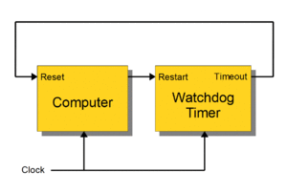
Watchdog
The hardware component of a watchdog is a counter:
set to a certain value
then counts down towards zero.
It is the responsibility of the software:
to set the count to its original value so that it never reaches zero.
If timer reaches zero:
it is assumed that the software has failed in some manner
CPU is reset.

Slide 10
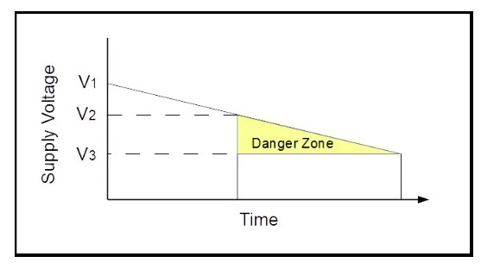
Brownout Detection
A “brown out” of a microcontroller is a partial and temporary reduction in the power supply voltage below the level required for reliable operation.
Many microcontrollers have a protection circuit which detects when the supply voltage goes below this level
puts the device into a reset state to ensure proper startup when power returns. This action is called a “Brown Out Reset” or BOR.

Slide 11
Brownout Detection
V1: is the normal power supply voltage. V2: is the point where the microcontroller may not operate reliably.
V3: a point where operation stops entirely.
Between V2 and V3 is a “danger zone” where things can go wrong and operation is unreliable.
The device could work correctly for years while the power supply goes in and out of the danger zone and then there is a failure.
The BOR level is set above V2 and replaces the danger zone with a reset of the device.
Reset is not good but (usually) better than uncertain.

Slide 12
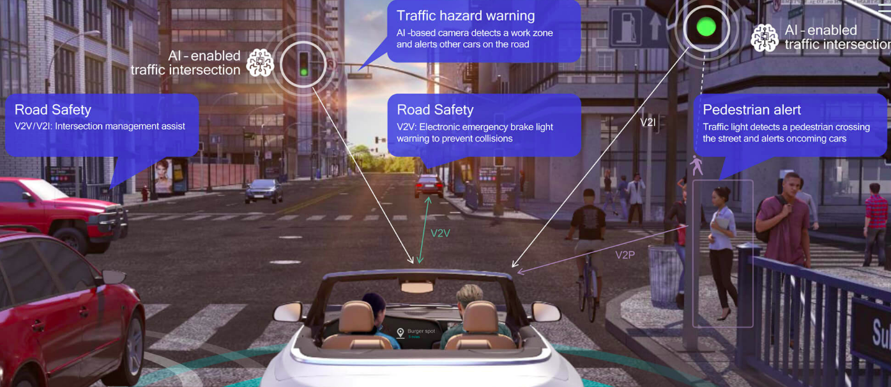
Artificial Intelligence in Critical Systems
Autonomous driving : prominent example for systems incorporating critical components derived using ML.
The capability of an AI system to react in complex scenarios in a short amount of time is unique
Enables the system to identify pedestrians or traffic signs in a fraction of classic image recognition methods used before.

Slide 13
Problems with AI-ML
ML methods are based on probabilities.
They are stochastic principles, which can only estimate the correct answer with a specific certainty.
Even though the ML algorithms might be 100% sure that the outcome is correct, the answer can still be wrong. This can e.g. happen if the quality of the training data is too low, or the data does not even contain all possible scenarios

Slide 14

Introduction to Machine Learning
Slide Ref: Introduction to Machine Learning, Eric Eaton

Slide 15
What is Machine Learning?
“Learning is any process by which a system improves performance from experience.”
- Herbert Simon
Definition by Tom Mitchell (1998):
Machine Learning is the study of algorithms that
improve their performance P
at some task T
with experience E.
A well-defined learning task is given by <P, T, E>.
3

Slide 16
Traditional Programming
Data Program
Computer
Output
Machine Learning
Data Output
Computer
Program
4
Slide credit: Pedro Domingos

Slide 17

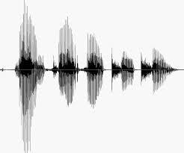
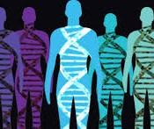
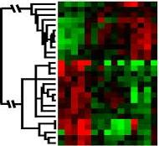
When Do We Use Machine Learning?
ML is used when:
Human expertise does not exist (navigating on Mars)
Humans can’t explain their expertise (speech recognition)
Models must be customized (personalized medicine)
Models are based on huge amounts of data (genomics)
Learning isn’t always useful:
There is no need to “learn” to calculate payroll
Based on slide by E. Alpaydin
5

Slide 18
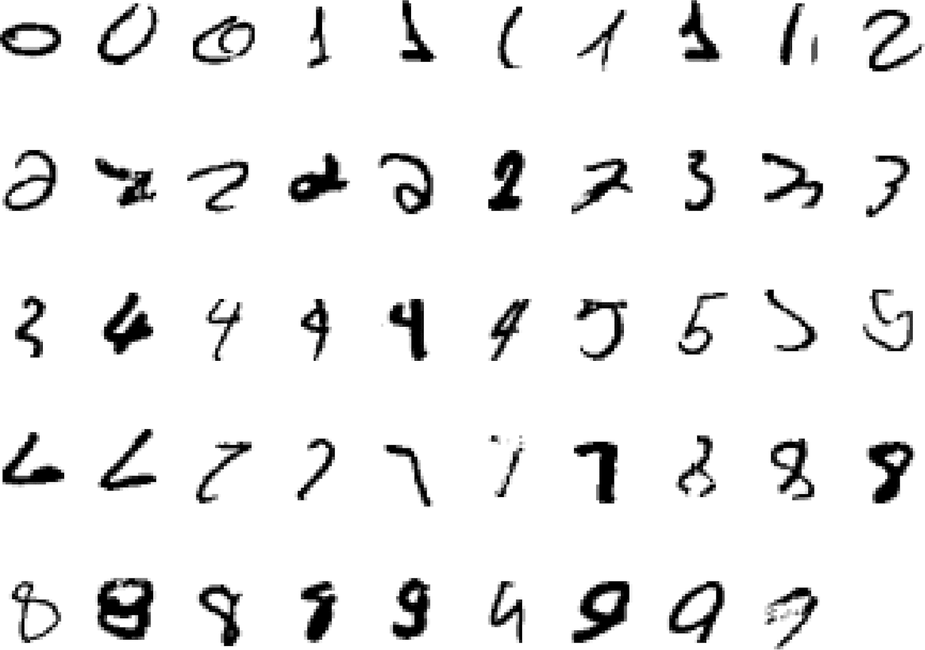
A classic example : It is very hard to say what makes 2
6
Slide credit: Geoffrey Hinton

Slide 19
Some more examples of Task
Recognizing patterns:
Facial identities or facial expressions
Handwritten or spoken words
Medical images
Generating patterns:
Generating images or motion sequences
Recognizing anomalies:
Unusual credit card transactions
Unusual patterns of sensor readings in a nuclear power plant
Prediction:
Future stock prices or currency exchange rates
7
Slide credit: Geoffrey Hinton

Slide 20
Sample Applications
Web search
Computational biology
Finance
E-commerce
Space exploration
Robotics
Information extraction
Social networks
Debugging software
[Your favorite area]
8
Slide credit: Pedro Domingos

Slide 21
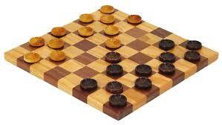
Samuel’s Checkers-Player
“Machine Learning: Field of study that gives computers the ability to learn without being explicitly programmed.” -Arthur Samuel (1959)
9

Slide 22
Defining the Learning Task
Improve on task T, with respect to performance metric P, based on experience E
T: Playing checkers
P: Percentage of games won against an arbitrary opponent
E: Playing practice games against itself
T: Recognizing hand-written words
P: Percentage of words correctly classified
E: Database of human-labeled images of handwritten words
T: Driving on four-lane highways using vision sensors
P: Average distance traveled before a human-judged error
E: A sequence of images and steering commands recorded while observing a human driver.
T: Categorize email messages as spam or legitimate. P: Percentage of email messages correctly classified. E: Database of emails, some with human-given labels

Slide 23
State of the Art Applications of Machine Learning

Slide 24
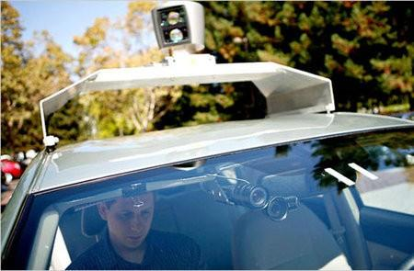
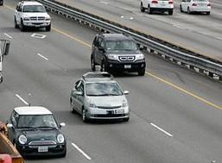
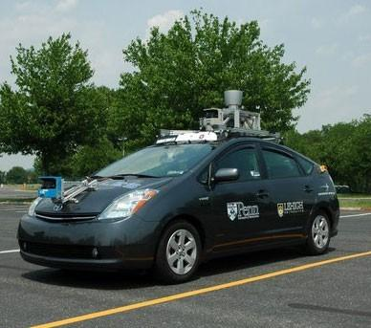
Autonomous Cars
Nevada made it legal for autonomous cars to drive on roads in June 2011
As of 2013, four states (Nevada, Florida, California, and Michigan) have legalized autonomous cars
Penn’s Autonomous Car 🡪
(Ben Franklin Racing Team)
12

Slide 25
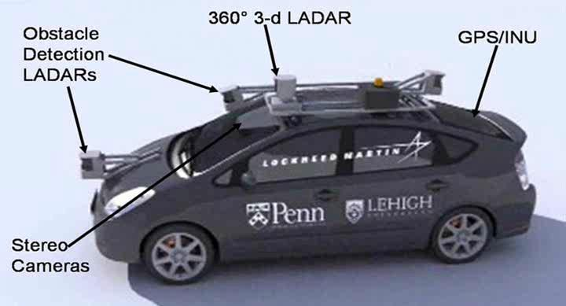
Autonomous Car Sensors
13

Slide 26
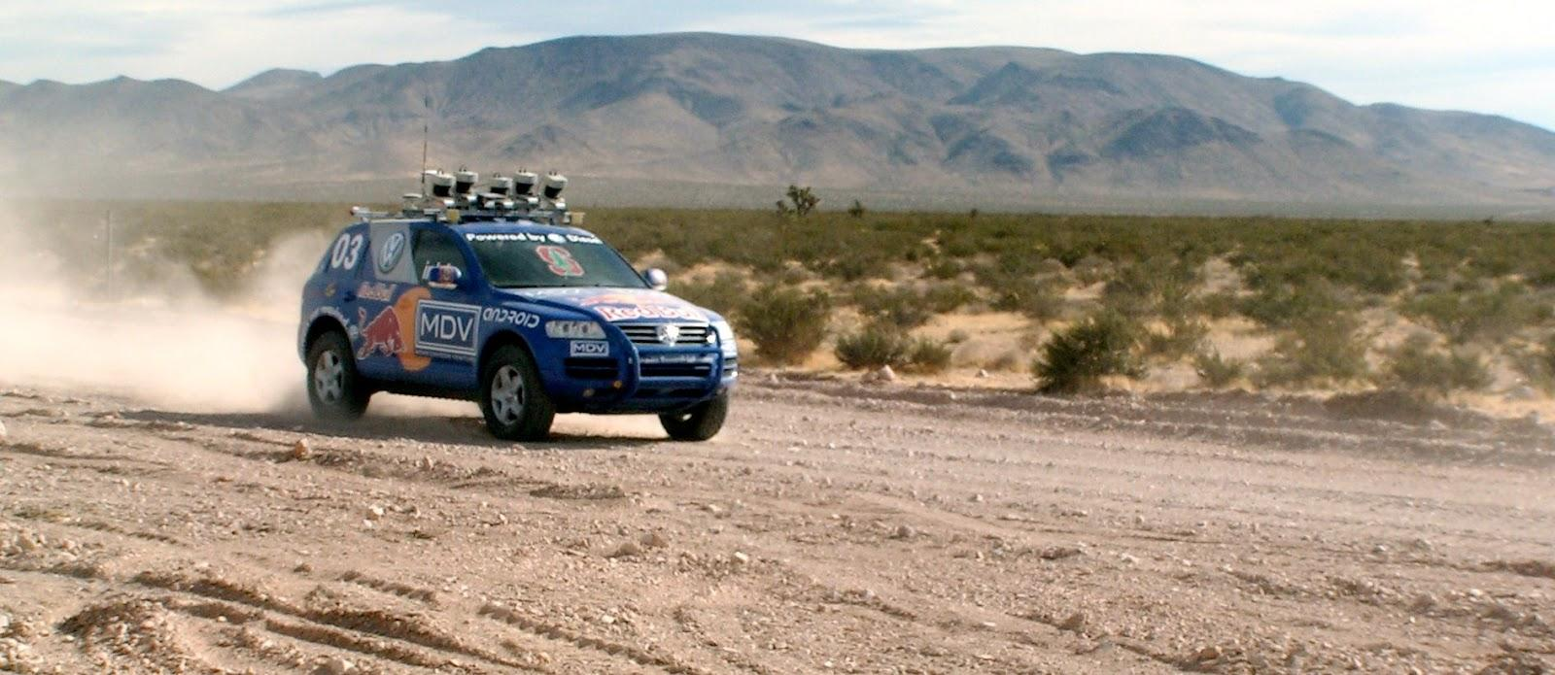
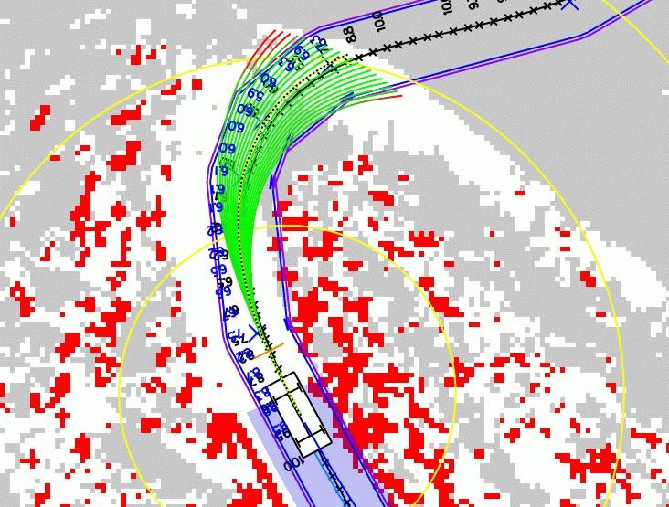
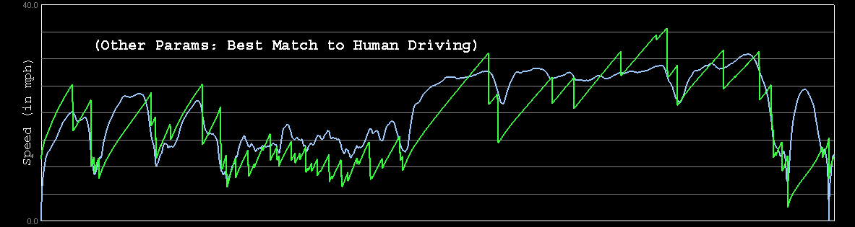

Autonomous Car Technology
Path Planning
Laser Terrain Mapping
Learning from Human Drivers
Sebastian
Adaptive Vision
Stanley
Images and movies taken from Sebastian Thrun’s multimedia w¹e⁴bsite.

Slide 27


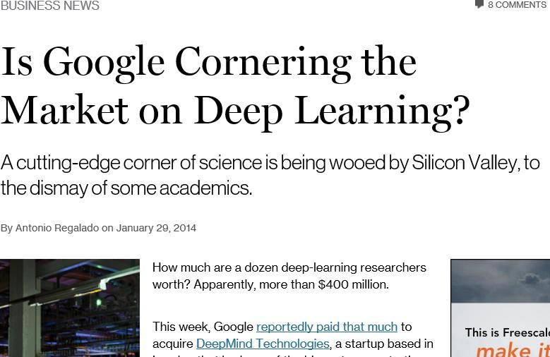
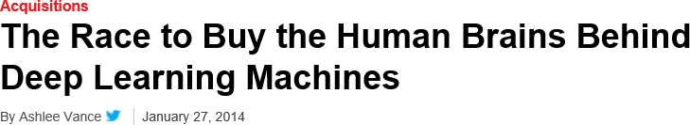
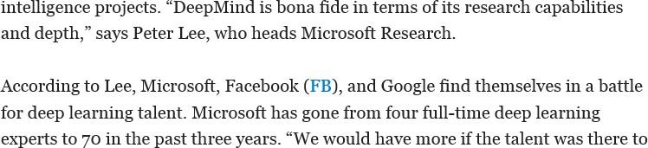
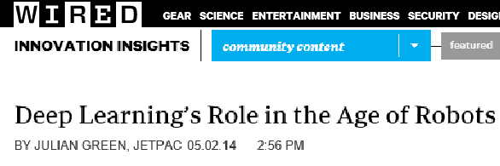
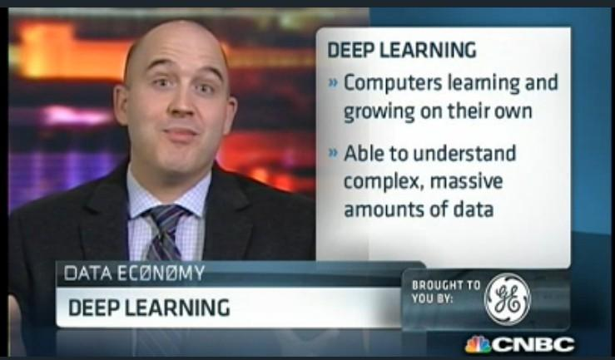
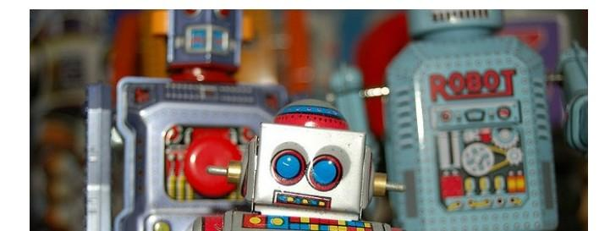
Deep Learning in the Headlines
15

Slide 28
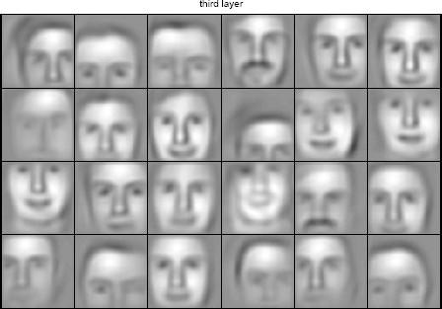
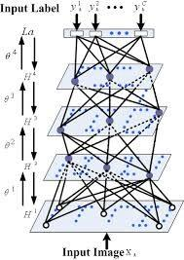

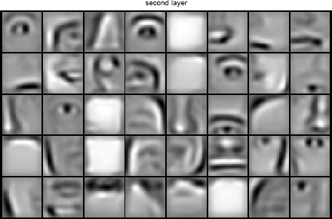



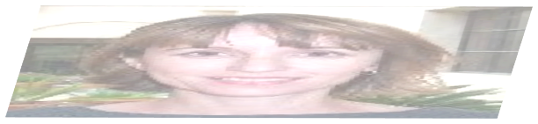



Deep Belief Net on Face Images
object models
object parts (combination of edges)
edges
pixels
Based on materials by Andrew Ng
16

Slide 29
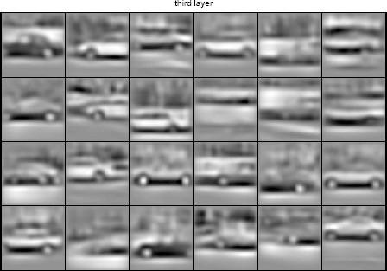
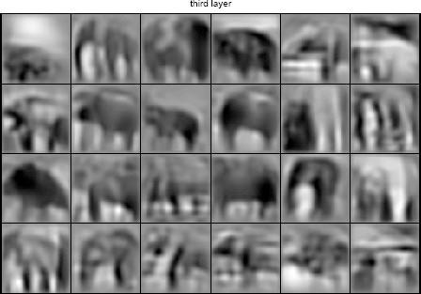
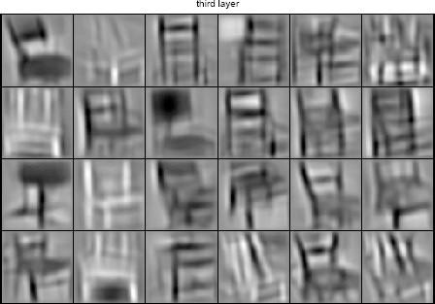
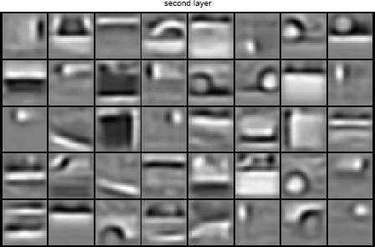
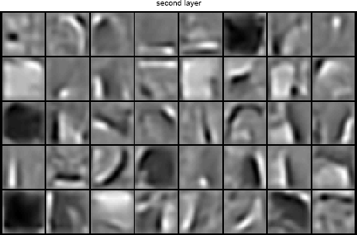
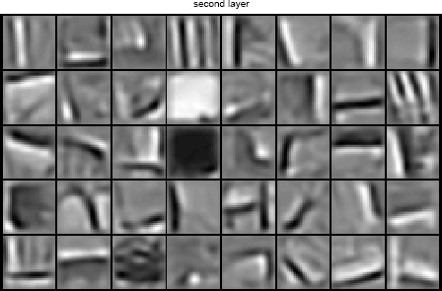
Learning of Object Parts
Slide credit: Andrew Ng

Slide 30
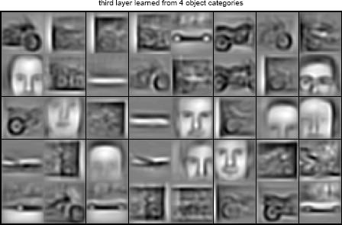
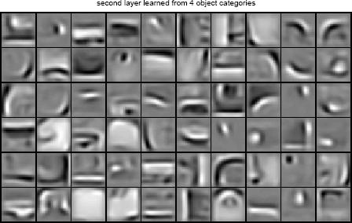
Training on Multiple Objects
Trained on 4 classes (cars, faces, motorbikes, airplanes).
Second layer: Shared-features and object-specific features.
Third layer: More specific features.
Slide credit: Andrew Ng

Slide 31
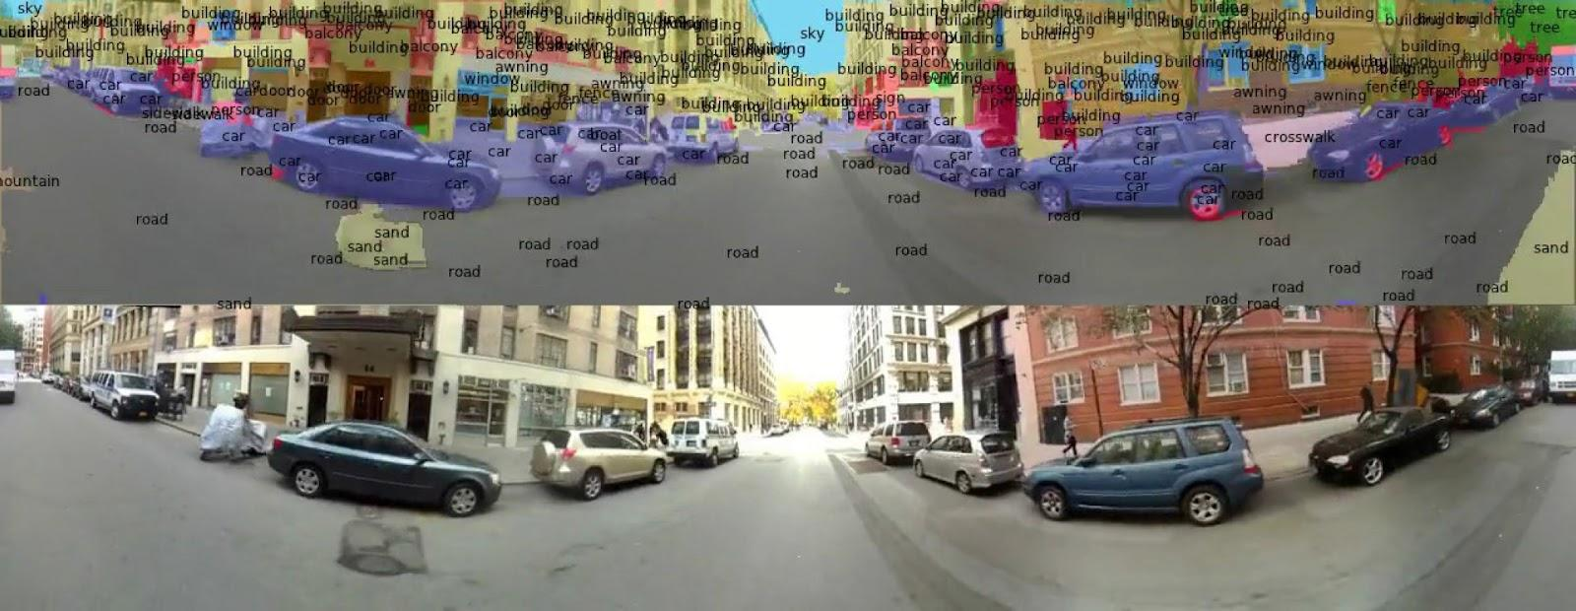
Scene Labeling via Deep Learning
[Farabet et al. ICML 2012, PAMI 2013]
19

Slide 32
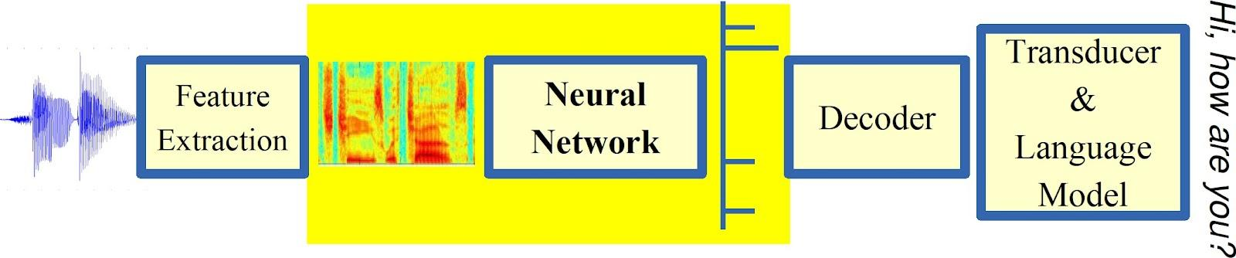
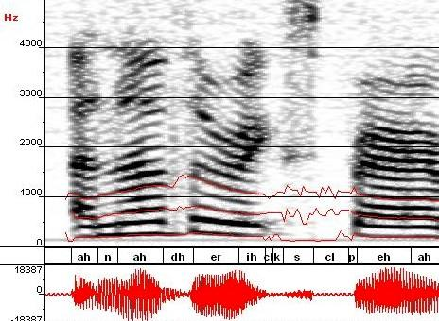
Machine Learning in Automatic Speech Recognition
A Typical Speech Recognition System
ML used to predict of phone states from the sound spectrogram
Deep learning has state-of-the-art results
# Hidden Layers | 1 | 2 | 4 | 8 | 10 | 12
Word Error Rate % | 16.0 | 12.8 | 11.4 | 10.9 | 11.0 | 11.1
Baseline GMM performance = 15.4%
[Zeiler et al. “On rectified linear units for speech recognition” ICASSP 2013]
21

Slide 33

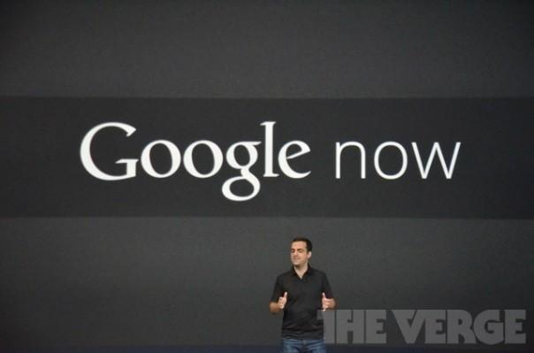





Impact of Deep Learning in Speech Technology
22
Slide credit: Li Deng, MS Research

Slide 34
Types of Learning
23

Slide 35
Types of Learning
Supervised (inductive) learning
Given: training data + desired outputs (labels)
Unsupervised learning
Given: training data (without desired outputs)
Semi-supervised learning
Given: training data + a few desired outputs
Reinforcement learning
Rewards from sequence of actions
Based on slide by Pedro Domingos
24

Slide 36



Supervised Learning: Regression
Given (x₁, y₁), (x₂, y₂), ..., (x_{n}, y_{n})
Learn a function f(x) to predict y given x
– y is real-valued == regression
9
8
7
6
5
4
3
2
1
0
1970 1980
September Arctic Sea Ice Extent (1,000,000 sq km)
1990 2000
2010
2020
Year
Data from G. Witt. Journal of Statistics Education, Volume 21, Number 1 (2013)
26

Slide 37










Supervised Learning: Classification
Given (x₁, y₁), (x₂, y₂), ..., (x_{n}, y_{n})
Learn a function f(x) to predict y given x
– y is categorical == classification
Cancer (Malignant / Benign)
1(Malignant)
0(Benign)
Tumor Size
27
Based on example by Andrew Ng

Slide 38












Supervised Learning
x can be multi-dimensional
– Each dimension corresponds to an attribute
Clump Thickness
Uniformity of Cell Size
Uniformity of Cell Shape
…
Age
Tumor Size
30
Based on example by Andrew Ng

Slide 39















Unsupervised Learning
Given x₁, x₂, ..., x_{n} (without labels)
Output hidden structure behind the x’s
– E.g., clustering
31

Slide 40

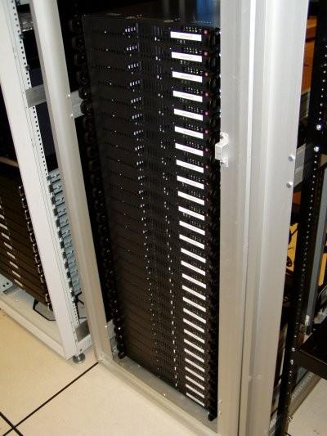
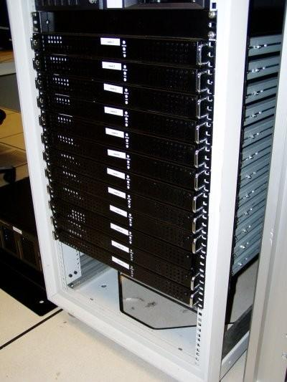




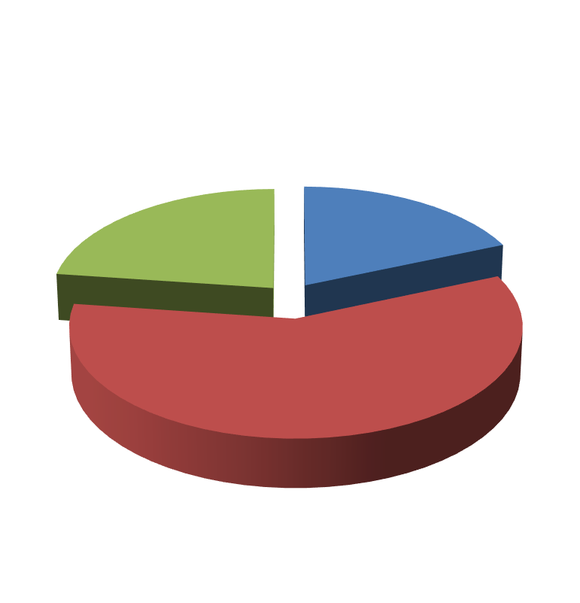

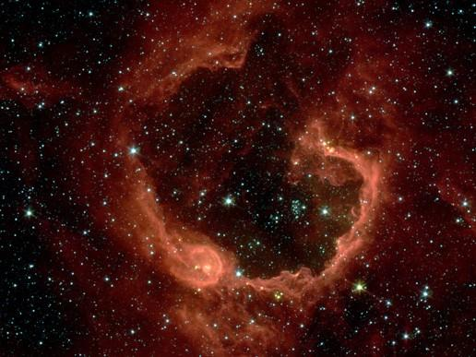


Unsupervised Learning
Organize computing clusters
Social network analysis
Market segmentation
Slide credit: Andrew Ng
Image credit: NASA/JPL-Caltech/E. Churchwell (Univ. of Wisconsin, Madison)
Astronomical data analysis
33

Slide 41
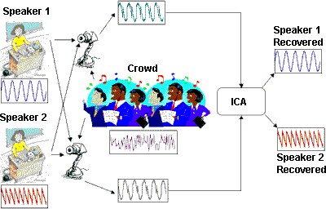


Unsupervised Learning
Independent component analysis – separate a combined signal into its original sources
Image credit: statsoft.com Audio from http://www.ism.ac.jp/~shiro/research/blindsep.html

Slide 42
Unsupervised Learning
Independent component analysis – separate a combined signal into its original sources
Image credit: statsoft.com Audio from http://www.ism.ac.jp/~shiro/research/blindsep.html

Slide 43
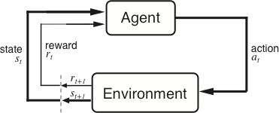
Reinforcement Learning
Given a sequence of states and actions with (delayed) rewards, output a policy
Policy is a mapping from states 🡪 actions that tells you what to do in a given state
Examples:
Credit assignment problem
Game playing
Robot in a maze
Balance a pole on your hand

Slide 44
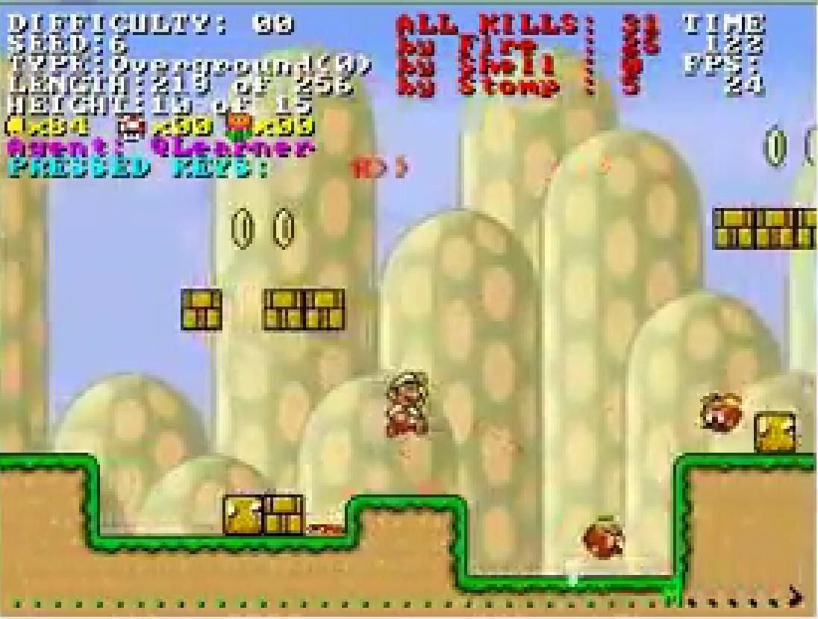
Reinforcement Learning
https://www.youtube.com/watch?v=4cgWya-wjgY
38

Slide 45

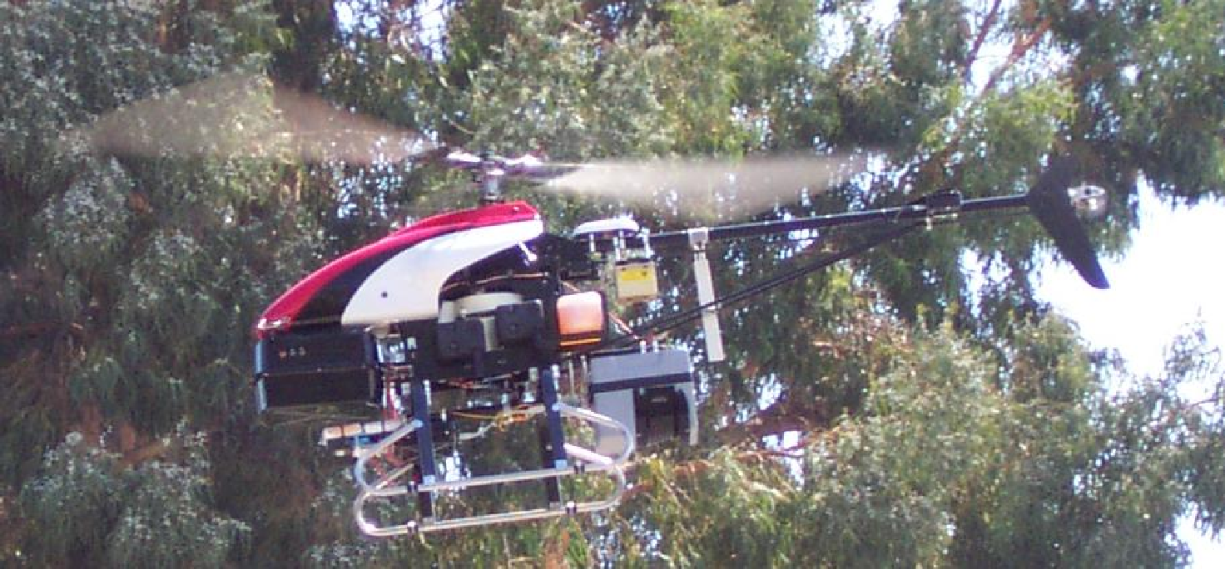
Inverse Reinforcement Learning
Learn policy from user demonstrations
Stanford Autonomous Helicopter http://heli.stanford.edu/ https://www.youtube.com/watch?v=VCdxqn0fcnE

Slide 46
Framing a Learning Problem

Slide 47






Designing a Learning System
Choose the training experience
Choose exactly what is to be learned
– i.e. the target function
Choose how to represent the target function
Choose a learning algorithm to infer the target function from the experience
Training data
Learner
Environment/ Experience
Knowledge
Testing data
Performance Element
Based on slide by Ray Mooney
41

Slide 48
Training vs. Test Distribution
We generally assume that the training and test examples are independently drawn from the same overall distribution of data
– We call this “i.i.d” which stands for “independent and identically distributed”
If examples are not independent, requires
collective classification
If test distribution is different, requires
transfer learning
Slide credit: Ray Mooney
42

Slide 49
ML in a Nutshell
Tens of thousands of machine learning algorithms
Hundreds new every year
Every ML algorithm has three components:
Representation
Optimization
Evaluation
43
Slide credit: Pedro Domingos

Slide 50
Various Function Representations
Numerical functions
Linear regression
Neural networks
Support vector machines
Symbolic functions
Decision trees
Rules in propositional logic
Rules in first-order predicate logic
Instance-based functions
Nearest-neighbor
Case-based
Probabilistic Graphical Models
Naïve Bayes
Bayesian networks
Hidden-Markov Models (HMMs)
Probabilistic Context Free Grammars (PCFGs)
Markov networks
Slide credit: Ray Mooney

Slide 51
Various Search/Optimization Algorithms
Gradient descent
Perceptron
Backpropagation
Dynamic Programming
HMM Learning
PCFG Learning
Divide and Conquer
Decision tree induction
Rule learning
Evolutionary Computation
Genetic Algorithms (GAs)
Genetic Programming (GP)
Neuro-evolution
Slide credit: Ray Mooney

Slide 52
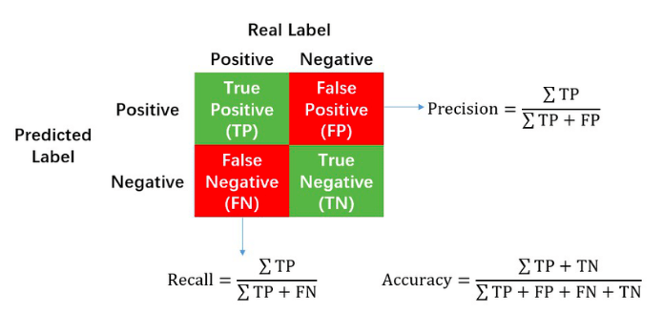
Evaluation
Accuracy
Precision and recall
Squared error
Likelihood
Posterior probability
Cost / Utility
Margin
Entropy
K-L divergence etc
[A true positive is an outcome where the model correctly predicts the positive class. Similarly, a true negative is an outcome where the model correctly predicts the negative class.]
47
Slide credit: Pedro Domingos

Slide 53


ML in Practice
Understand domain, prior knowledge, and goals
Data integration, selection, cleaning, pre-processing, etc.
Learn models
Interpret results
Consolidate and deploy discovered knowledge
Loop
48
Based on a slide by Pedro Domingos

Slide 54
A Brief History of Machine Learning
50

Slide 55
History of Machine Learning
1950s
Samuel’s checker player
Selfridge’s Pandemonium
1960s:
Neural networks: Perceptron
Pattern recognition
Learning in the limit theory
Minsky and Papert prove limitations of Perceptron
1970s:
Symbolic concept induction
Winston’s arch learner
Expert systems and the knowledge acquisition bottleneck
Quinlan’s ID3
Michalski’s AQ and soybean diagnosis
Scientific discovery with BACON
Mathematical discovery with AM
Slide credit: Ray Mooney

Slide 56
History of Machine Learning (cont.)
1980s:
Advanced decision tree and rule learning
Explanation-based Learning (EBL)
Learning and planning and problem solving
Utility problem
Analogy
Cognitive architectures
Resurgence of neural networks (connectionism, backpropagation)
Valiant’s PAC Learning Theory
Focus on experimental methodology
Slide credit: Ray Mooney

Slide 57
History of Machine Learning (cont.)
1990s
Data mining
Adaptive software agents and web applications
Text learning
Reinforcement learning (RL)
Inductive Logic Programming (ILP)
Ensembles: Bagging, Boosting, and Stacking
Bayes Net learning
Slide credit: Ray Mooney

Slide 58
History of Machine Learning (cont.)
2000s
Support vector machines & kernel methods
Graphical models
Statistical relational learning
Transfer learning
Sequence labeling
Collective classification and structured outputs
Computer Systems Applications (Compilers, Debugging, Graphics, Security)
E-mail management
Personalized assistants that learn
Learning in robotics and vision
Based on slide by Ray Mooney

Slide 59
History of Machine Learning (cont.)
2010s
Deep learning systems
Learning for big data
Bayesian methods
Multi-task & lifelong learning
Applications to vision, speech, social networks, learning to read, etc.
– Many More To Come!!!!!
Based on slide by Ray Mooney

Slide 60
Summary
Machine learning seeks to develop methods for computers to improve their performance at certain tasks on the basis of observed data.
Typical example:
detecting pedestrians in images taken from an autonomous vehicle,
classifying gene-expression patterns from leukaemia patients into subtypes by clinical outcome,
or translating English sentences into French.
scope of machine-learning tasks is even broader than these pattern classification or mapping tasks, and can include optimization and decision making, compressing data and automatically extracting interpretable models from data.

Slide 61
Data: The Treasure
Almost all machine-learning tasks can be formulated as making inferences about missing or latent data from the observed data [inference, prediction or forecasting]
Example :
Consider classifying people with leukaemia into one of the four main subtypes of this disease on the basis of each person’s measured gene-expression patterns. Observed data : pairs of gene-expression patterns and labelled subtypes, Unobserved or missing data: subtypes for new patients.
To make inferences about unobserved data from the observed data:
the learning system needs to make some assumptions
taken together these assumptions constitute a model.

Slide 62
Model
A model can be very simple and rigid [classic statistical linear regression model]
Model can be complex and flexible [llarge and deep neural network]
A model is considered to be well defined if it can make forecasts or predictions about unobserved data having been trained on observed data
if the model cannot make predictions it cannot be falsified, in the sense of the philosopher Karl Popper’s proposal for evaluating hypotheses, or as the theoretical physicist Wolfgang Pauli said the model is “not even wrong”).
Any sensible model will be uncertain when predicting unobserved data, uncertainty plays a fundamental part in modelling.

Slide 63
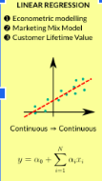

Rigid Linear Regression
Linear Regression is greatly affected by the presence of Outliers, linearity assumption
An outlier is an unusual observation of response y, for some given predictor x.
Logistic regression assumes linearity of independent variables and log odds.

Slide 64

Flexible deep NN
DNNs is a challenge since they typically require billions of expensive arithmetic computations.
DNNs are typically deployed in ensemble to boost accuracy performance, which further exacerbates the system requirements.
This computational overhead is an issue for many platforms, e.g. data centers and embedded systems, with tight latency and energy budgets.
Flexible DNNs: achieves large reduction in average inference latency while incurring small to negligible accuracy drop

Slide 65





Regression analysis helps in the prediction of a continuous variable
Which model to choose?

Slide 66
Problem 1: Uncertainty in Modelling

Slide 67
Uncertainty in Modelling
At the lowest level, model uncertainty is introduced from measurement noise, for example, pixel noise or blur in images.
At higher levels, a model may have many parameters, such as the coefficients of a linear regression, and there is uncertainty about which values of these parameters will be good at predicting new data.
Finally, at the highest levels : uncertainty about even the general structure of the model:
Is linear regression or a neural network appropriate, if the latter, how many layers should it have, and so on.

Slide 68
Probabilistic approach to modelling
uses probability theory to express all forms of uncertainty .
probability distributions are used to represent all the uncertain unobserved quantities in a model
structural, parametric and noise-related
how they relate to the data.

Slide 69
Probabilistic approach to modelling
basic rules of probability theory are used to infer the unobserved quantities given the observed data.
Learning from data occurs through the transformation of the prior probability distributions (defined before observing the data), into posterior distributions (after observing data).
The application of probability theory to learning from data is called Bayesian learning

Slide 70

Bayesian machine learning: How to choose ?
x and y: observed or uncertain quantities, taking values in some sets X and Y, respectively.
For example, x and y might relate to the weather in Cambridge and London, respectively, both taking values in the set X=Y={rainy,cloudy,sunny}
P(x) : probability of x
P(x,y) is the joint probability of observing x and y,
P(y|x) is the probability of y conditioned on observing the value of x

Slide 71


Bayesian machine learning: How to choose?*
Since P(x,y) and P(y,x) are commutative:
Apply probability theory to machine learning by replacing the symbols above:
Replace x by D to denote the observed data
Replace y by θ to denote the unknown parameters of a model
Ref: *https://www.nature.com/articles/nature14541.pdf

Slide 72

Compositional probabilistic models
Simple probability distributions over single or a few variables can be composed to form the building blocks of larger, more complex models.
Representing such compositional probabilistic models: graphical models

Slide 73
Problem 2: Overfitting of ML nets

Slide 74
Why Overfitting?
Overfitting is a modeling error in statistics that occurs when a function is too closely aligned to a limited set of data points
Example:
A traffic sign recognition system has to learn signs, but all STOP signs are only captured in an alley.
The ML algorithm is likely to learn, that a sign in an alley is a STOP sign and therefore detecting every traffic sign in an alley as such. Or a STOP sign, that is not located in an alley can not be detected.
This is caused by a low variance in the data, with a high bias

Slide 75

Overfitting underfitting details
A network is overfitting when a model’s training error (computed on a training set) is much lower than its generalization error (computed on a test or validation set).
This is opposite to underfitting, when a model is not able to obtain a sufficiently low error value on its training set.

Slide 76

Bias is the difference between the average prediction of our model and the correct value which we are trying to predict.
Variance refers to the changes in the model when using different portions of the training data set [variance is the expectation of the squared deviation of a random variable from its population mean or sample mean.]

Slide 77
Problem 3: Edge Cases

Slide 78
Edge Cases
Unexpected scenarios that occur so irregularly or even seldom are called Edge Cases
often not covered in any training data, simply because they are not anticipated during the system development.
All can possibly lead to accidents, when the systems deals with them in a wrong way.
Example:
A vehicle that is only used in sunny weather for a long time in the same environment, will override some of the learned features trained by the manufacturer.
handling intersections and performing turns as well as crossing the intersection.

Slide 79
Solution
Learning algorithms could continue to evolve while in operation
this approach is also called continuous or on-the-fly learning.
Actually this approach is often seen as similar to human learning processes.
Drawback:
potentially unwanted behavior
the training can not be influenced in a suitable way
dynamic changes to a certified system in general is not permitted by the current regulations and standards

Slide 80


Test Case
To understand the implication of critical components based on machine learning, HAW Hamburg uses miniature vehicles
Testing on use cases:
obstacle detection for autonomous driving.
recognition of traffic signs
obstacles in the driving lane
route detection
Fault tree analysis

Slide 81
In Summary
As a concrete example, consider adversarial examples, small perturbations of input examples that make even a highly accurate ML model give incorrect predictions.
Adversarial examples can be used to regularize the training procedure and make a model robust to small perturbations of data (which is a special case of stability).
Adversarial examples can be used as explanations by providing the minimal changes in the input that would alter the model prediction on it (counterfactual explanations).
Adversarial examples that only change certain protected attributes like gender or race can be used to verify and optimize for fairness (fairness audit).

Slide 82
Refs
Torge Hinrichs, Bettina Buth:Can AI-based Components be Part of Dependable Systems? IV 2020: 226-231
Reliable Machine Learning, https://www.microsoft.com/en-us/research/group/reliable-machine-learning/

